Slide 1

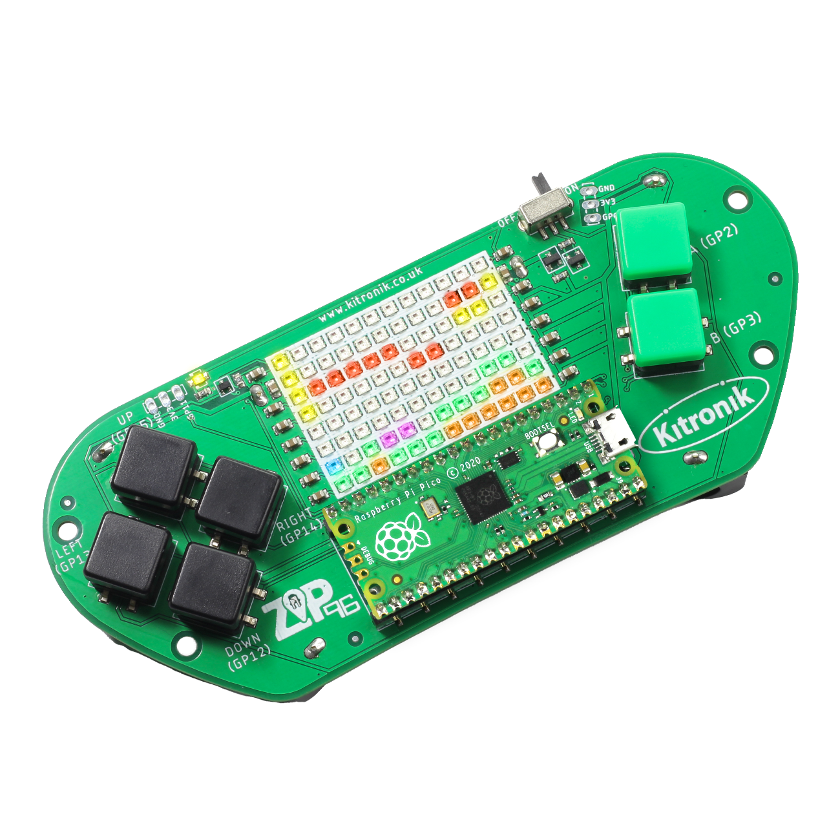
creating the a-mazing game
Computer Science

Slide 2

Aims & objectives
Computer Science
By the end of this lesson you will have:
Been introduced to the Pico ZIP96.
Been given the A-Mazing Game brief.
Explored the software design process.
Used the process to design the software for the A-Mazing Game.

Slide 3
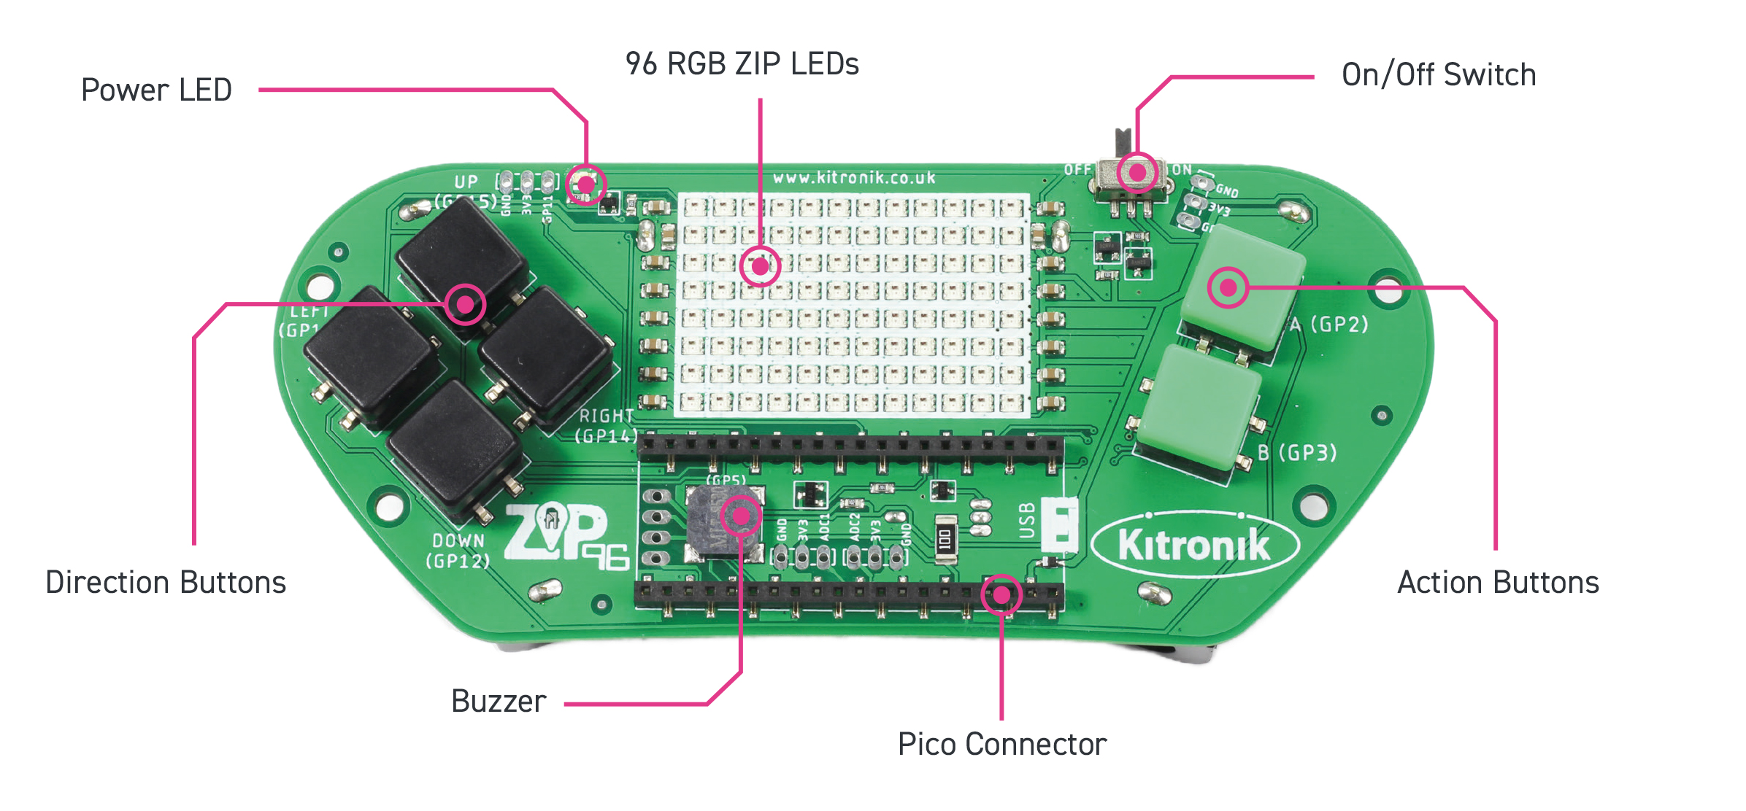
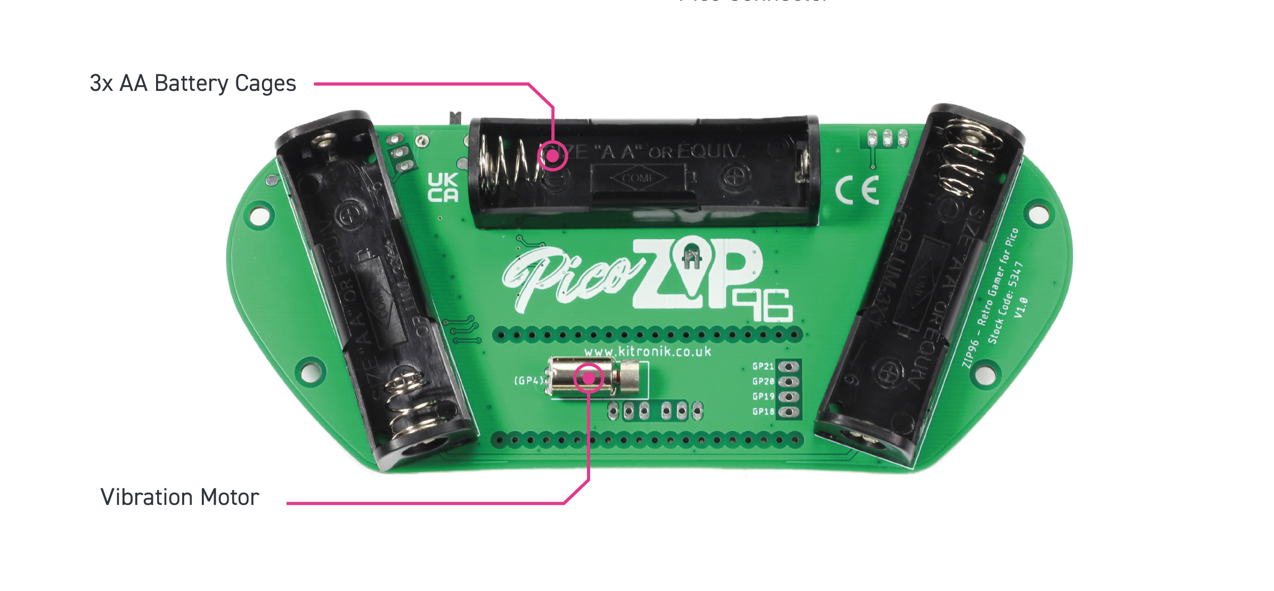
Pico zip96 Hardware
Computer Science

Slide 4
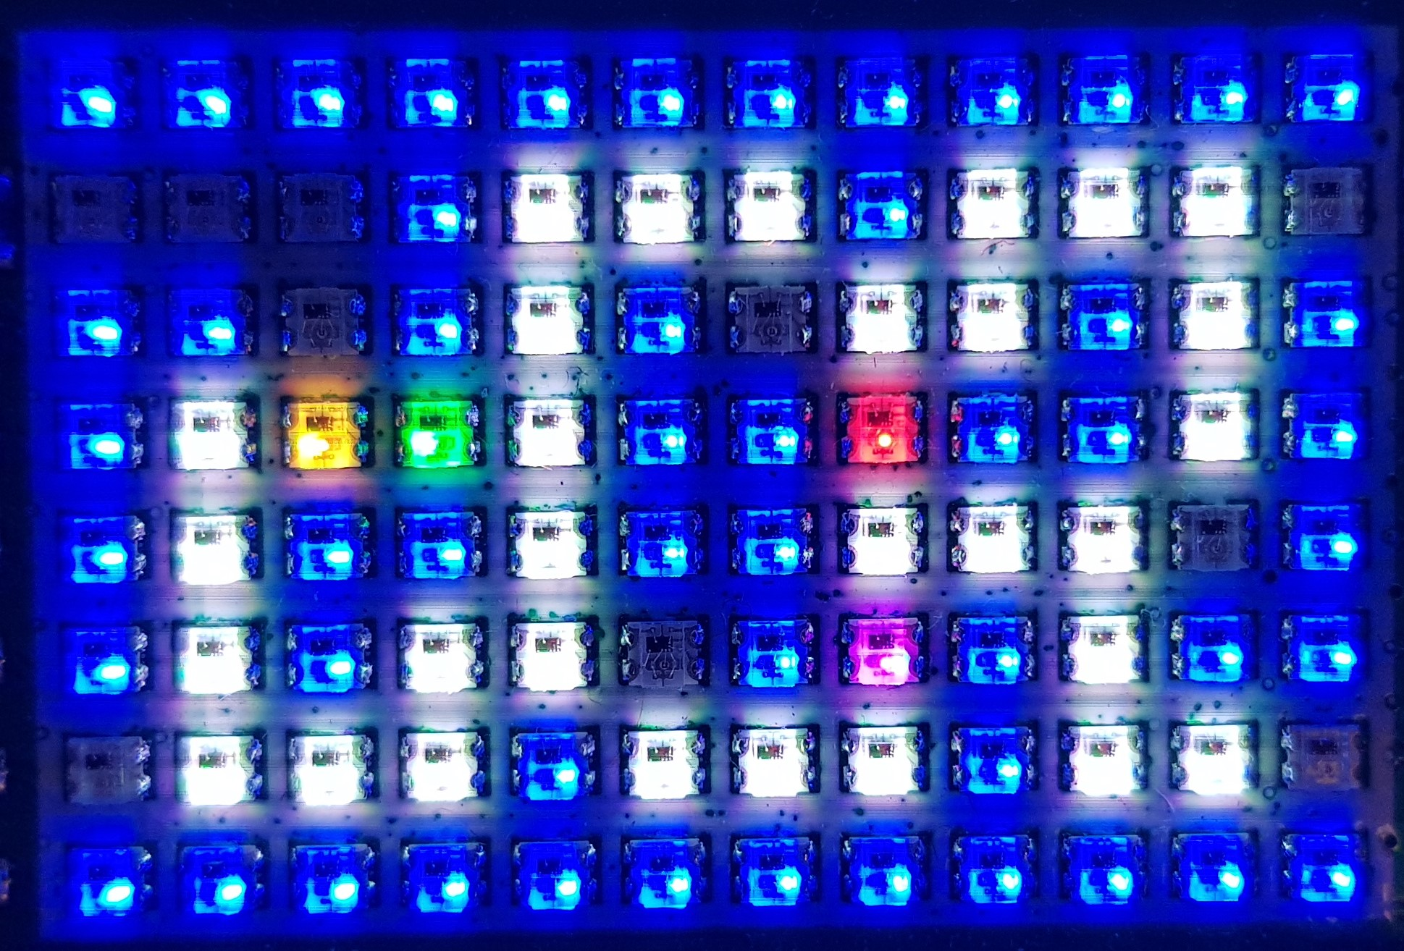
What is our a-mazing game?
Computer Science
A maze-based game where the player runs through a maze collecting gems – collect all the gems to win.
Three different enemies move around the maze as well, trying to stop the player from collecting gems.
One enemy moves randomly, one simply tries to move towards the player, the final one is smart and finds the best path through the maze to the player.
If an enemy catches the player, they lose a life. Once all three lives are lost… game over!

Slide 5
Software design
Computer Science
What the software should do, and how it should be built to achieve these things.
Good software design ensures the project requirements are met.
Enables the software to be broken down into smaller sections; built up to create the full program.

Slide 6

Program requirements
Computer Science
After reading the A-Mazing Game brief, what are the key requirements for the software?

Slide 7
Program requirements
Computer Science
After reading the A-Mazing Game brief, what are the key requirements for the software?
Player moves around the maze.
Player cannot move into the walls.
Player collects gems:
When all gems are collected, the players wins.
Player has three lives to win the game.
Enemies move around the maze.
Enemies cannot move into walls.
Enemies try to catch the player:
When an enemy catches the player, the player loses a life.

Slide 8
Programming concepts
Computer Science
Class:
A class is a blueprint or template for a set of related code.
Object:
The actual running copy of a class.

Slide 9
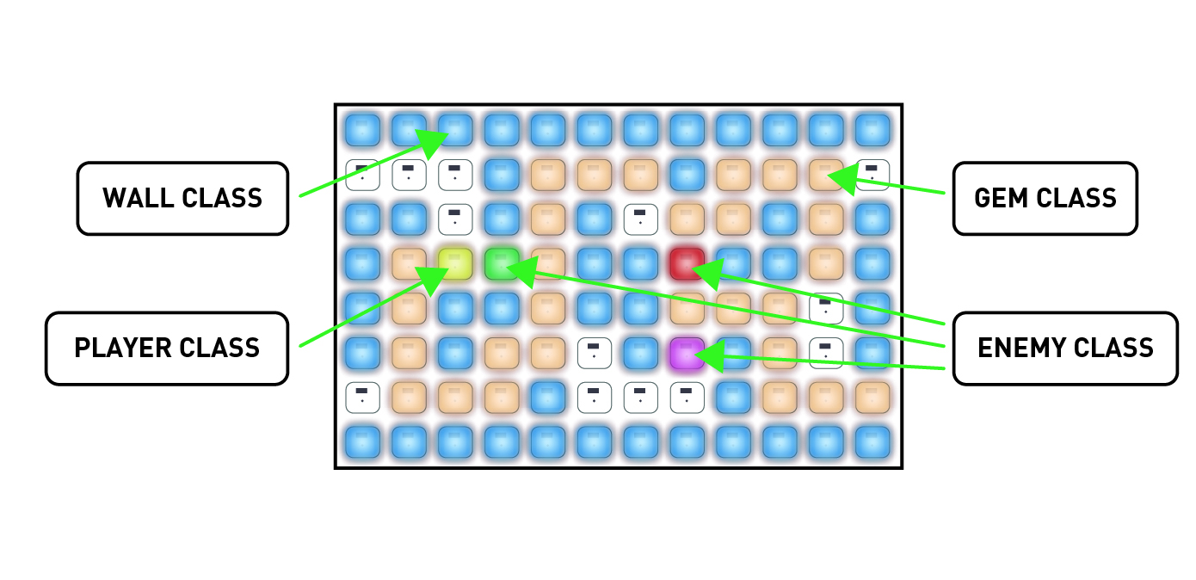
Classes in the game
Computer Science

Slide 10
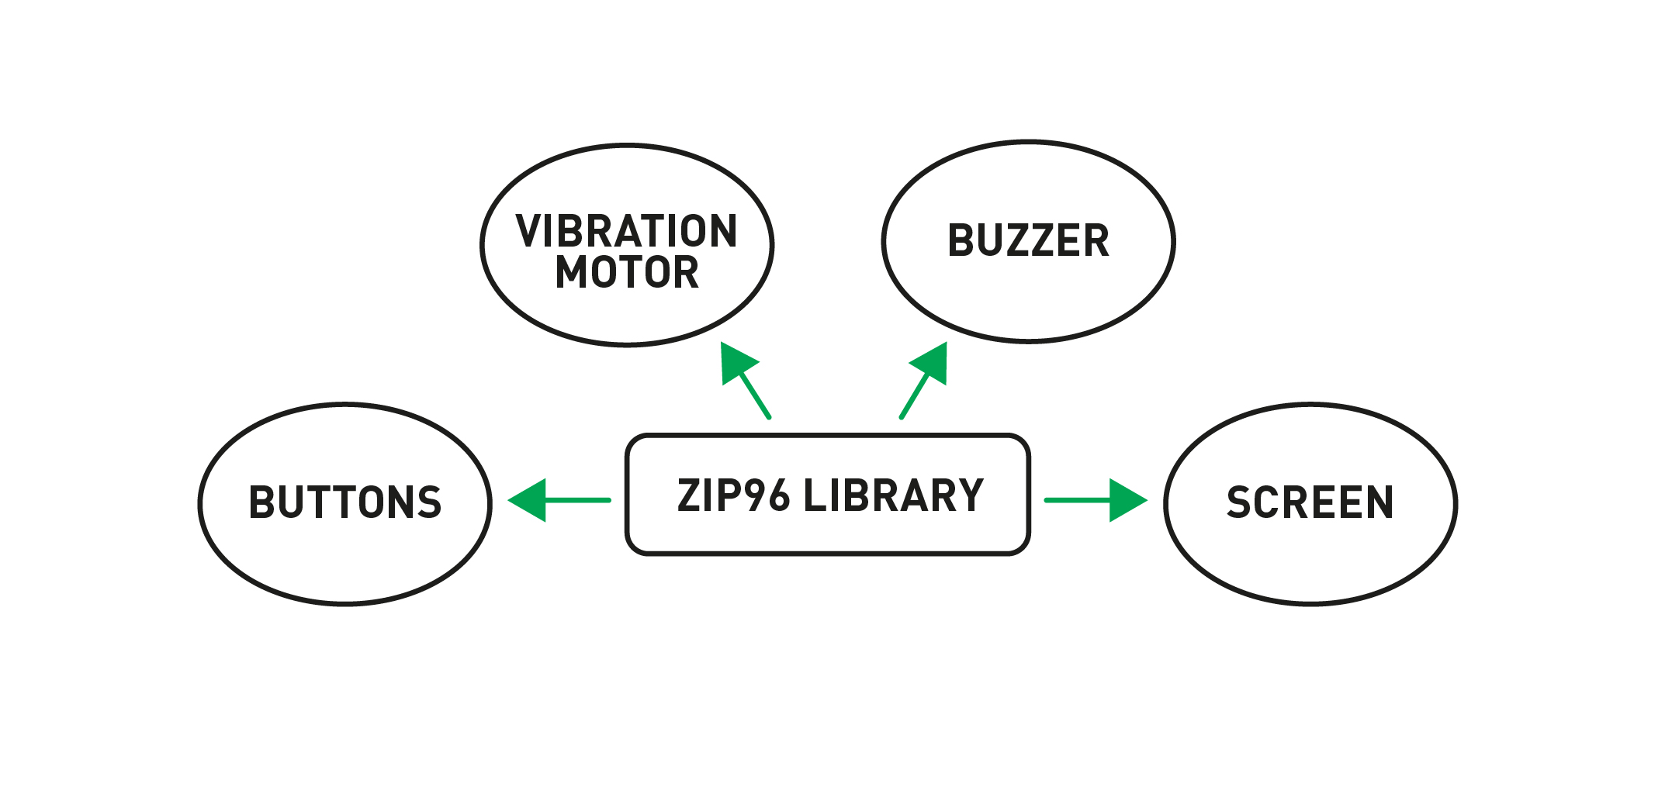
Pico Zip96 library features
Computer Science

Slide 11
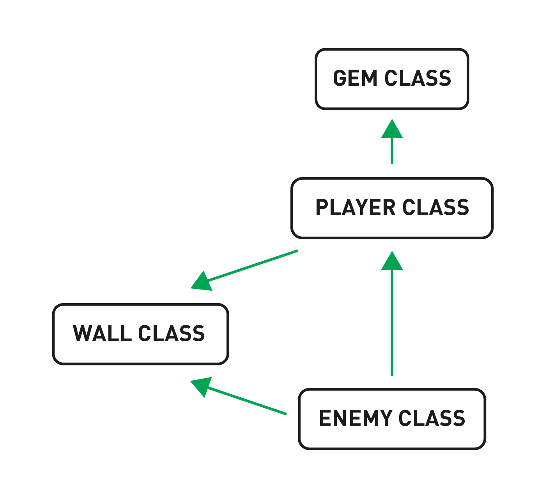
Class interaction
Computer Science

Slide 12
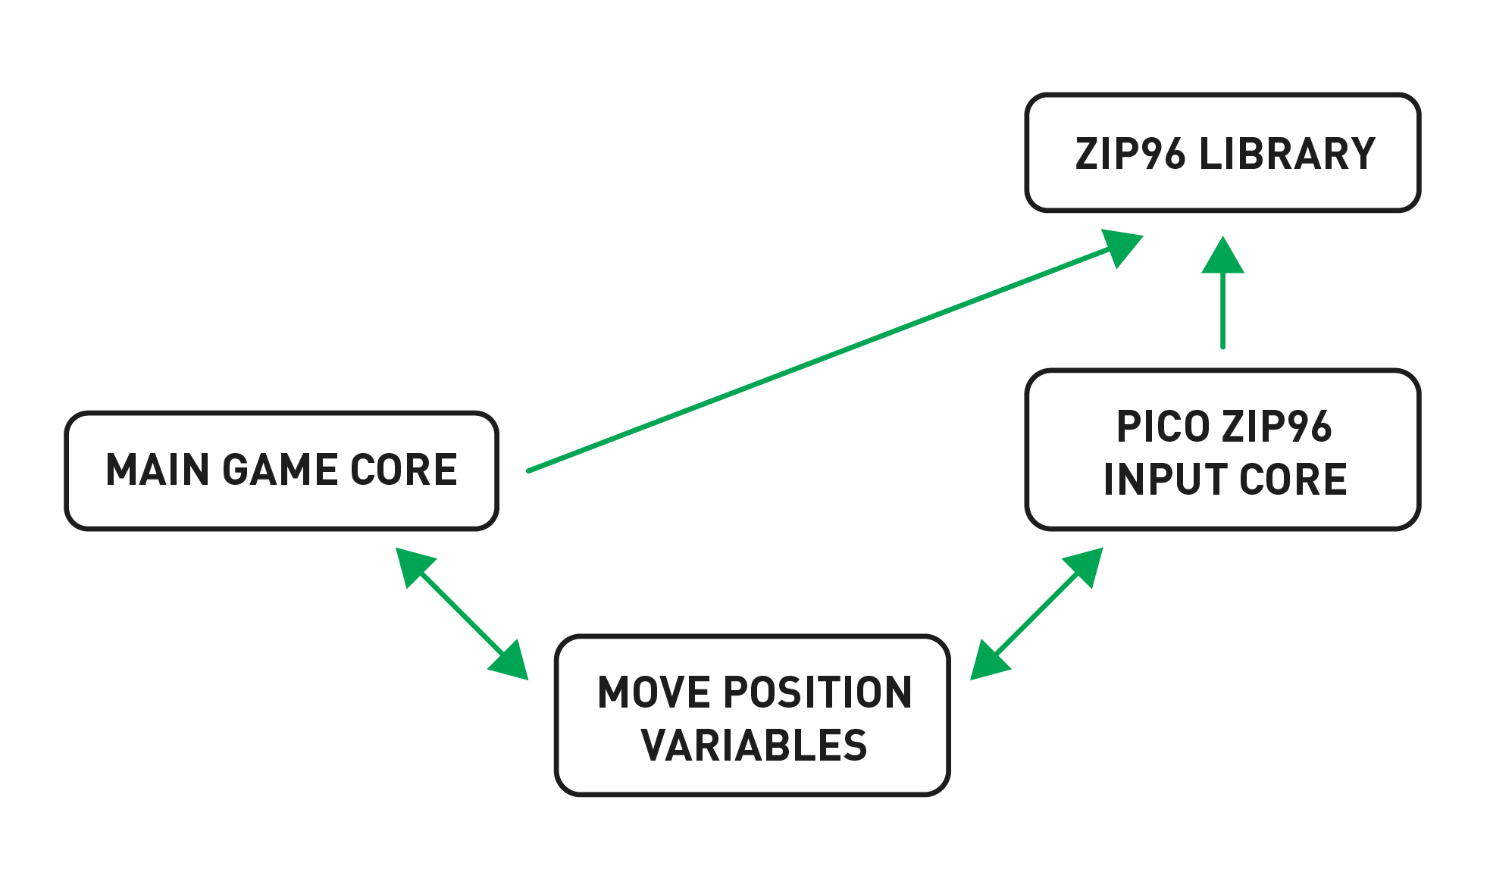
Game core interaction
Computer Science

Slide 13
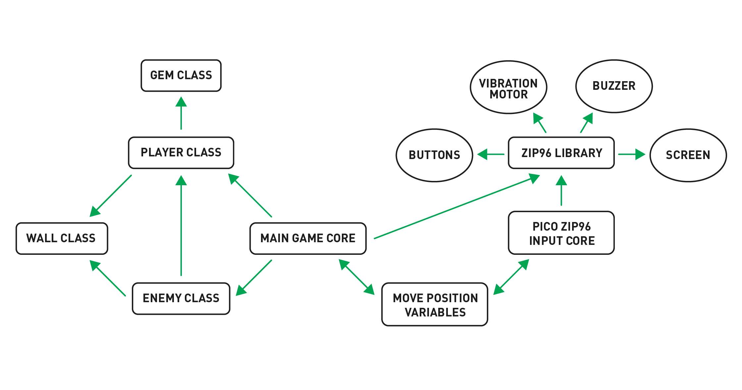
Complete design
Computer Science

Slide 14
conclusion
Computer Science
In this lesson you have:
Explored the concepts of:
Libraries
Classes
Objects
Designed the A-Mazing Game.

